Slide 1
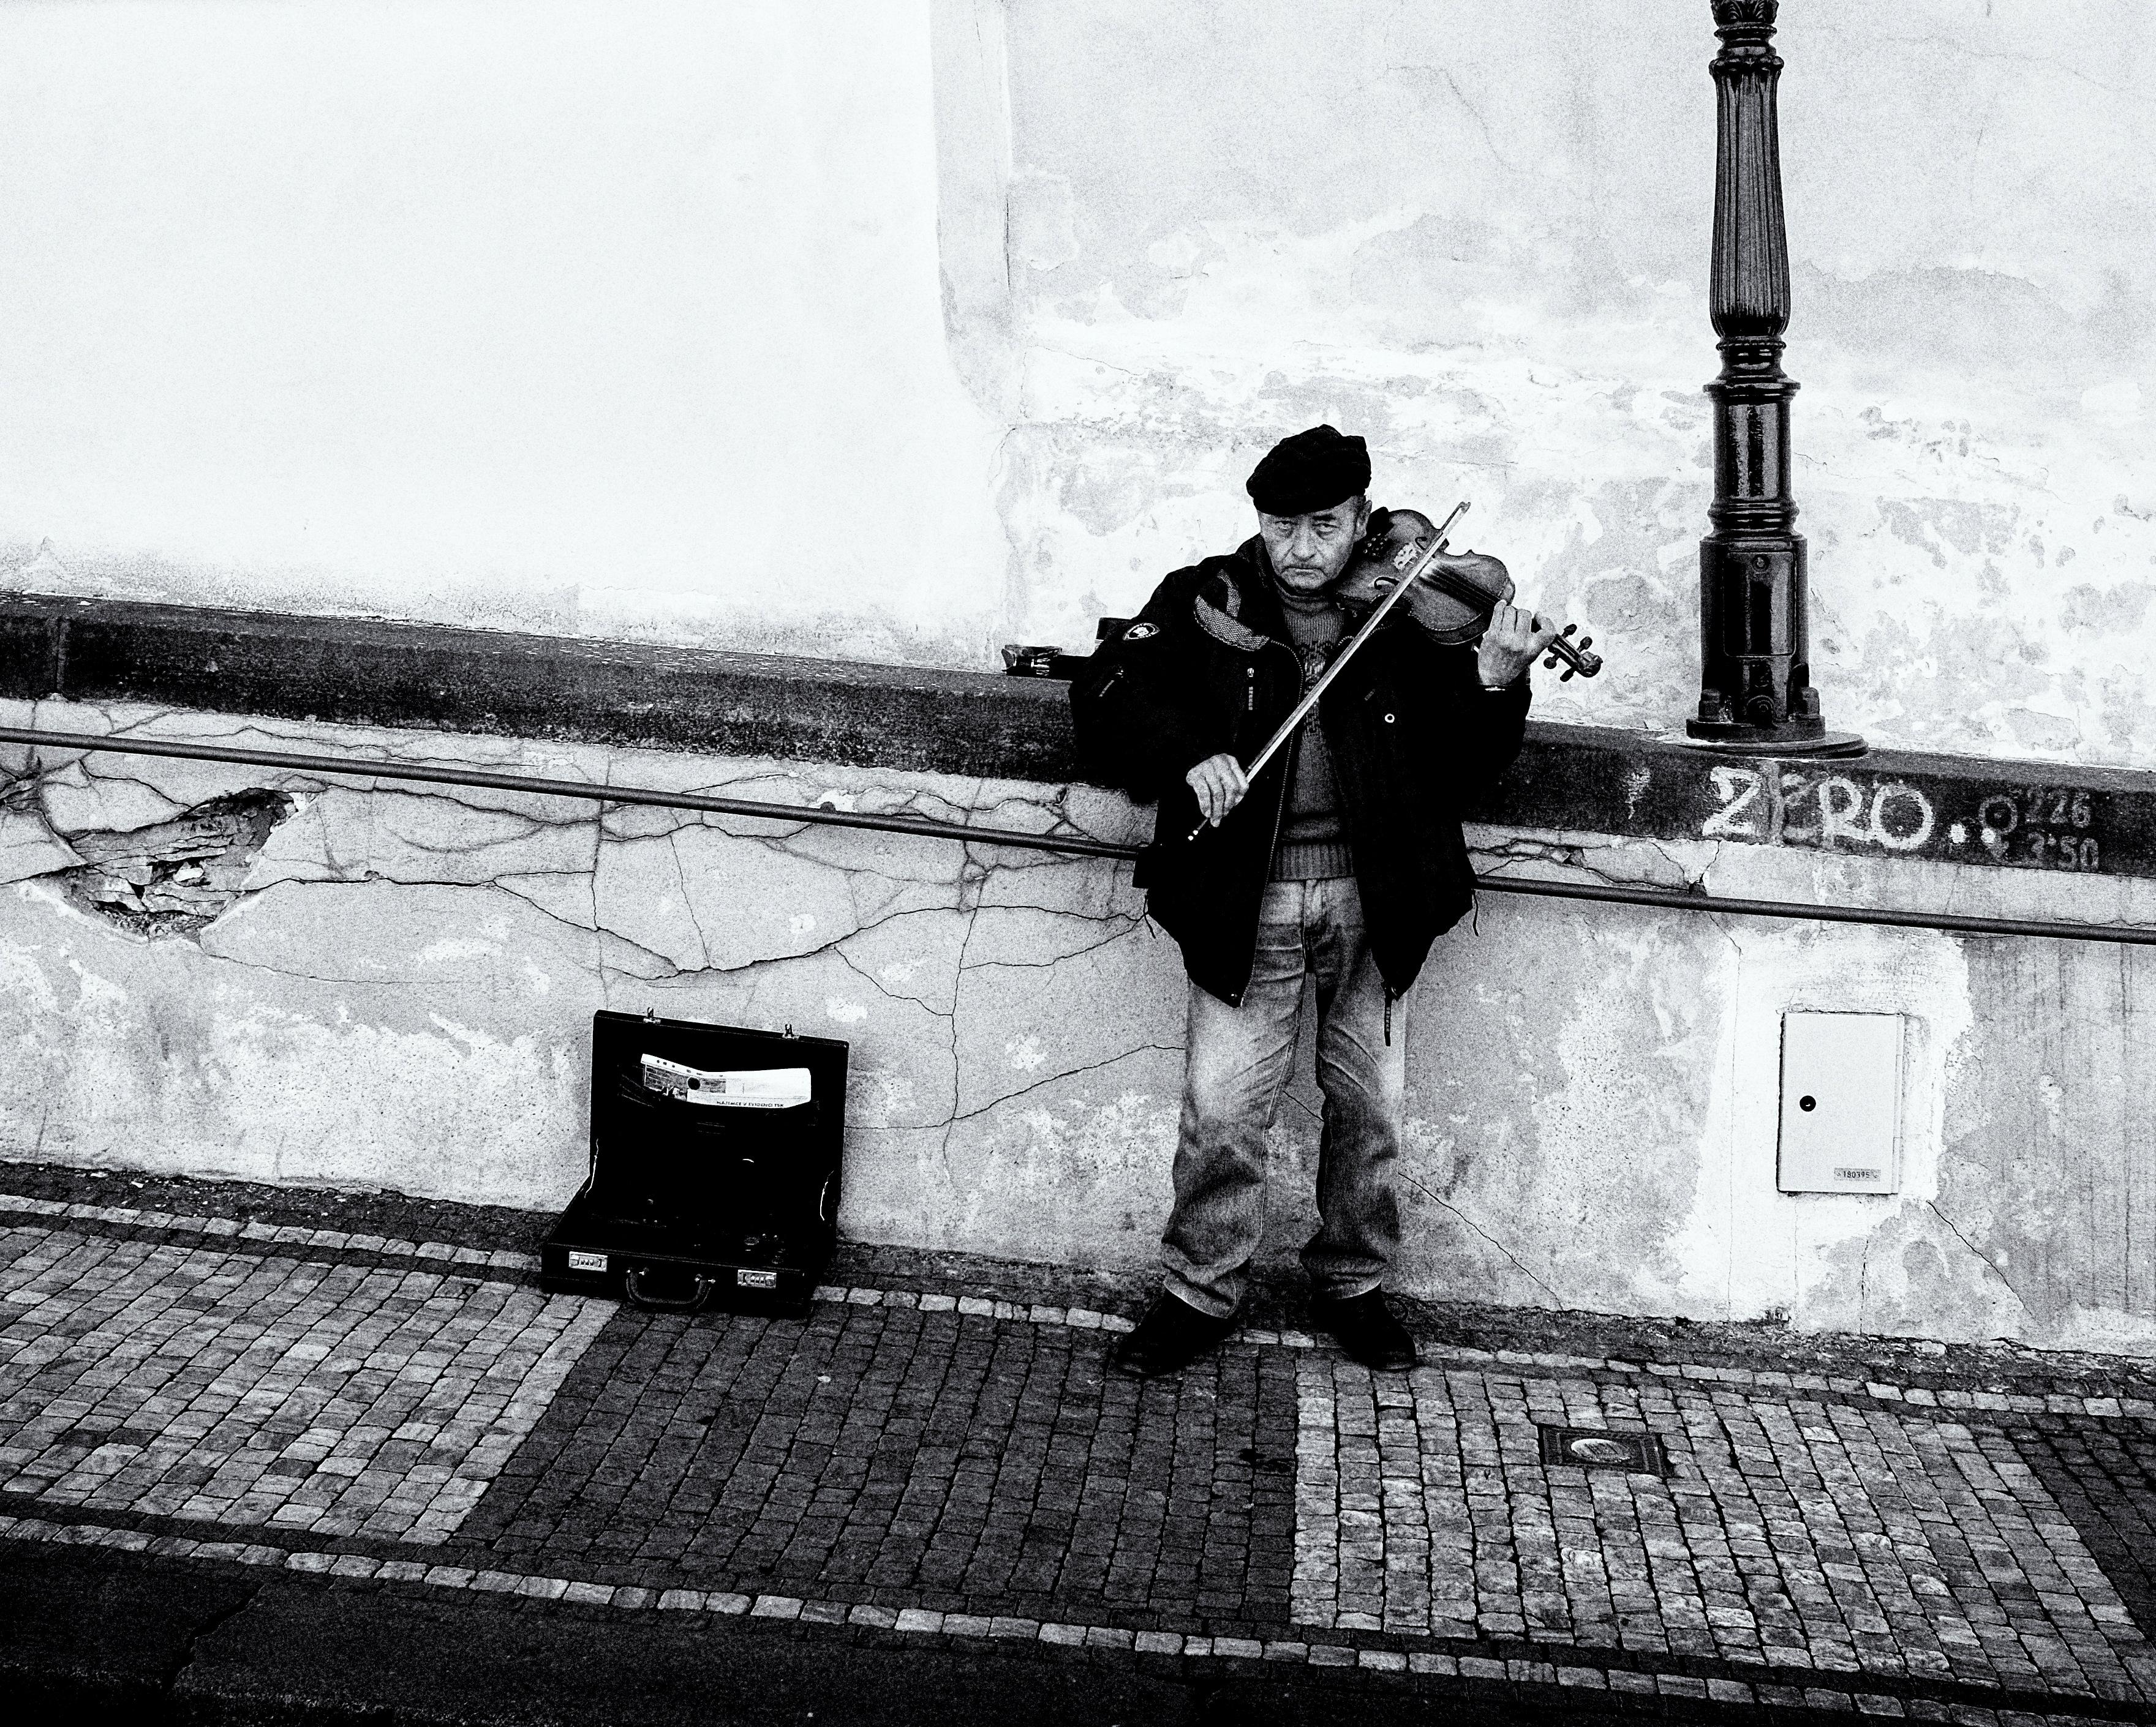
The Essential Man

Slide 2
What is wrong with these sentences? How do you know?
In 2010 Roger Ebert is sitting down to watch a movie with other movie critics.
He came to the screening room since 1976.
Today Ebert has decided to watch only one film. He did not have the time or energy for more.

Slide 3

A Close Look
What is the text’s big issue (main idea)?
  Cite three pieces of evidence that show the development of this main idea.
  Explain how the evidence supports the main idea.
Select words, phrases, or sentences that Ebert uses to describe what he thinks it means to be alive. (Note: Most of his quotations appear in italics in the text)

Slide 4

A Comparison
Next, Pick out parts of the text that Hamlet or the musician would find interesting or compelling. Explain why Hamlet or musician would be attracted to that part of text.

Slide 5

Heart to Heart
Have either the individual who wrote your song or Hamlet interview Ebert or vice versa.
What five questions would these individuals ask one another? Make sure you stick to how each person would likely answer. Answer the questions.

Slide 6

Style
How does Jones’ description of Ebert’s reaction to Broken Embraces help us to understand Ebert’s character? What words or phrases reveal Ebert’s attitude toward the experience of watching this film.
Jones writes that, at the film, “it looks as though [Ebert’s] sitting on top of a cloud of paper.” Jones then describes how Ebert “kicks his notes into a small pile with his feet.” Why are these images important? What side of Ebert’s personality do they reveal?
What does Jones mean when he says that the moment Ebert said his last words before losing the ability to talk to cancer “wasn’t cinematic”? Why is this significant?
What details are important in Jones’ description of Ebert’s second-floor library? What do the objects in the room suggest about his current life?
Why does Jones say reading Ebert’s post-cancer online journal is like “watching an Aztec pyramid being built?

Slide 7

Predict, Define, Create a sentence
Compensate
Disparity
Inconsolable
Indignant
Solidarity
Concoct
Analogy

Slide 8

While you are reading!
Look for the main issues.
  What are the various stances people take on these issues.
How is “life” defined in the text?

